Slide 1
Local elections play a major role in the economic future of the Big First
Dave Trabert, Kansas Policy Institute

Slide 2
About Kansas Policy Institute
Non-profit research and education organization with offices in Wichita and Overland Park.
Protect constitutional rights, promote policies to hold taxes down, and create better educational opportunities.
2 subsidiaries:
Sentinel online news service
Kansas Justice Institute; public-interest litigation center

Slide 3
Local elections and the future of the Big First
Are your property taxes reasonable?
Are school districts properly preparing kids for college and career?
Do rural co-op electric rates encourage economic development?
Do you want local officials to mandate how to build fences and how you can use your land?
If any answer is ‘no,’ how will anything change if you aren’t engaged?

Slide 4
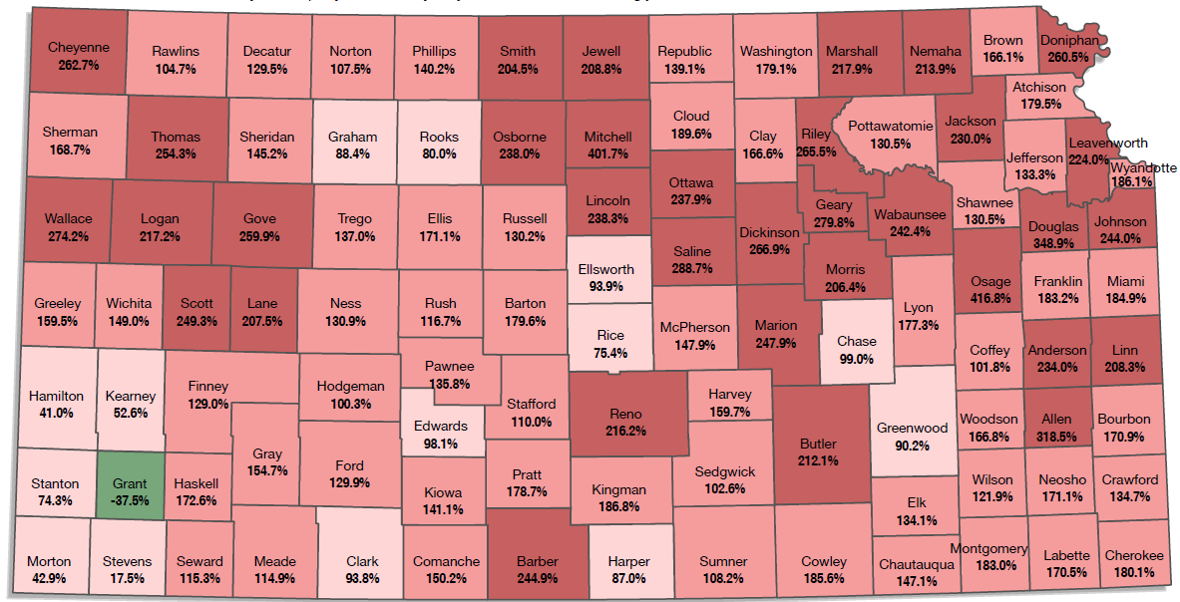
County property tax hikes, 1997 - 2018

Slide 5
Local officials use your money to lobby against you and against property tax honesty
SB 13 would make city and county officials vote on the entire property tax increase they impose.
Cities and counties openly opposed last year; asking to have it delayed this year because they are too busy.
Sedgwick County supports SB 13 because a commissioner persuaded his colleauges to change their minds.
Tell state reps you want SB 13 approved as passed by the Senate.

Slide 6
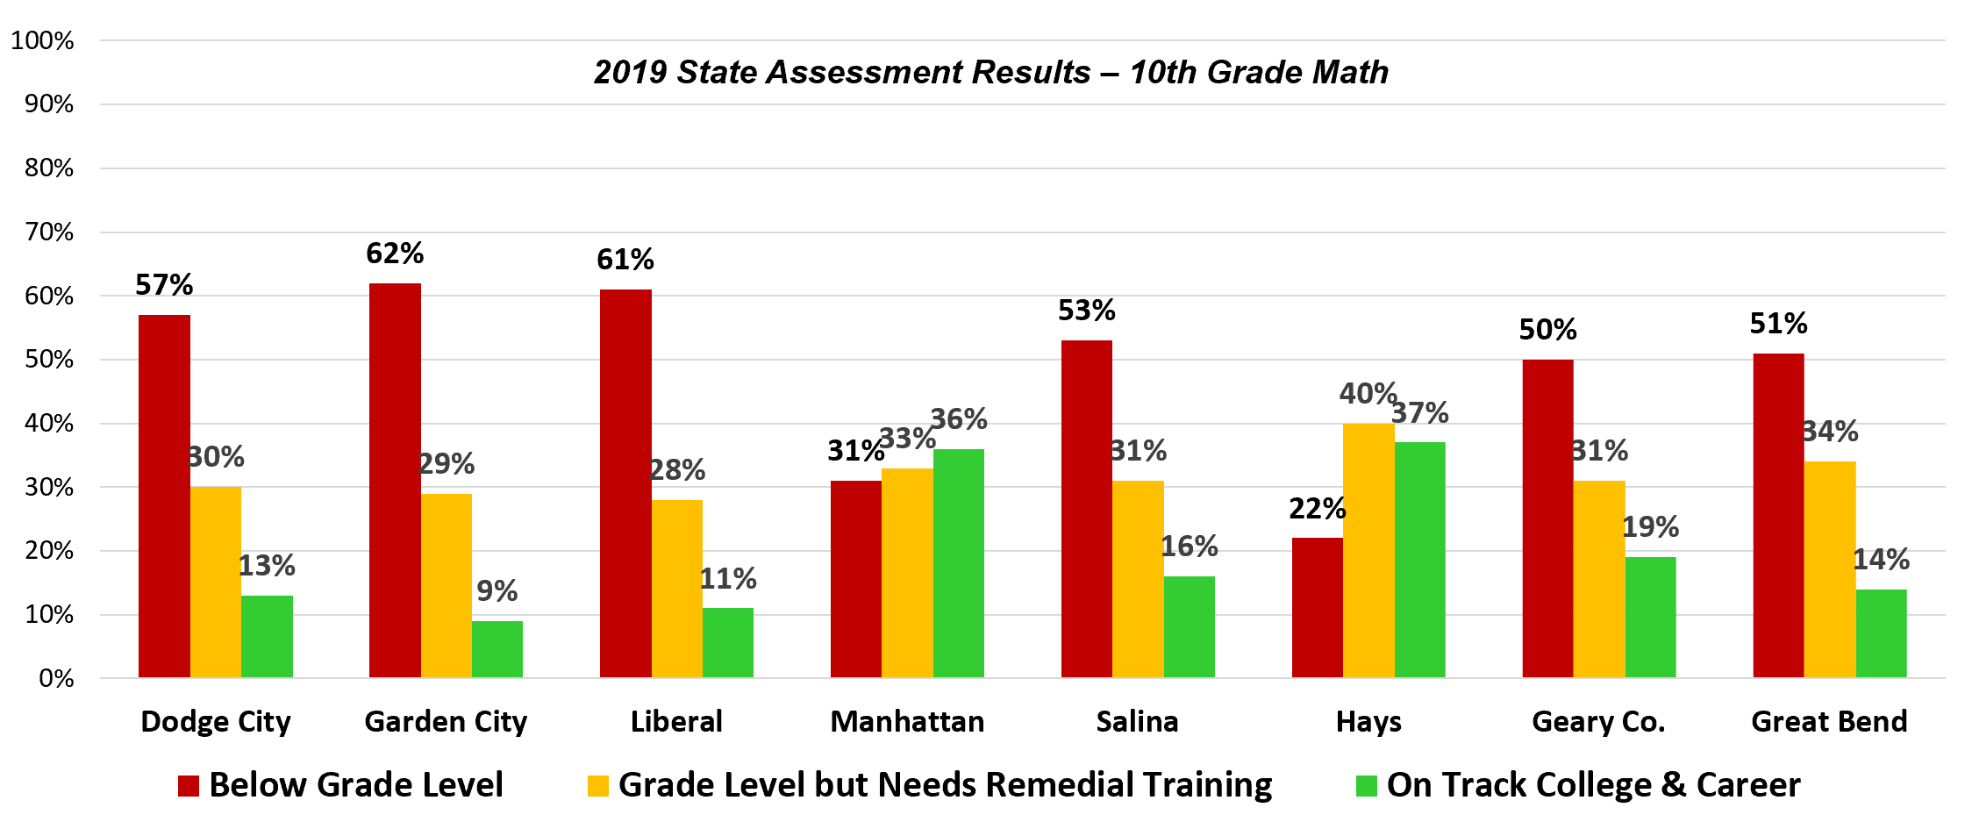
Many school districts have more kids below grade level than on track for college or career

Slide 7
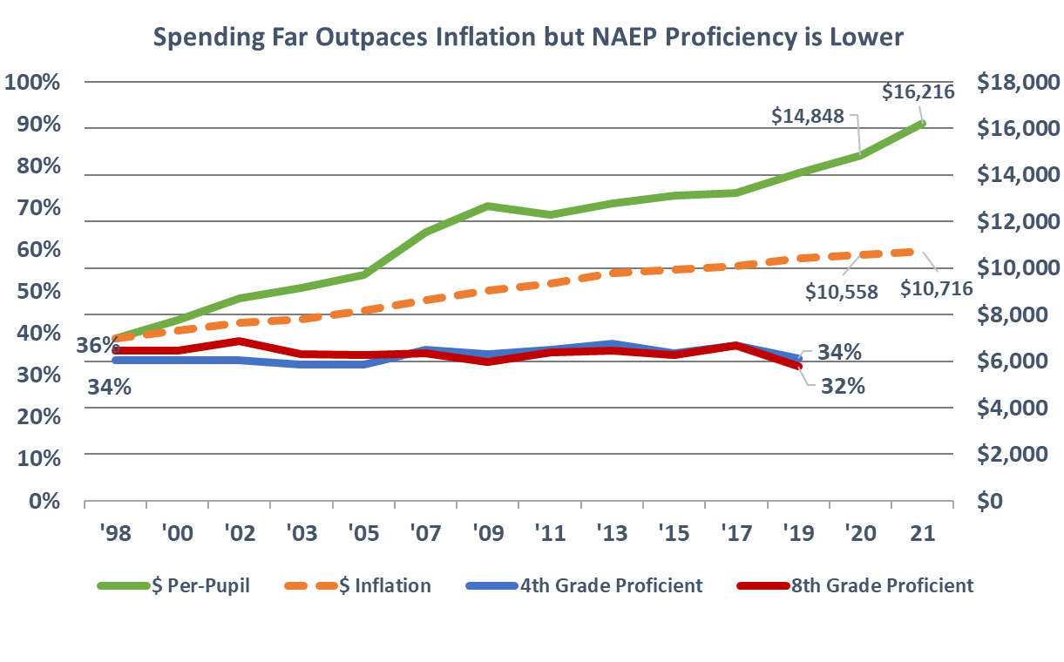
Achievement declining statewide while funding explodes

Slide 8
School board members use your money to lobby against accountability
HB 2067 would require districts to allocate sufficient funding within available resources so that all students may (essentially) achieve grade level.
“… if this passes, we’d be held accountable! “
Uh, yeah, that’s the point.

Slide 9
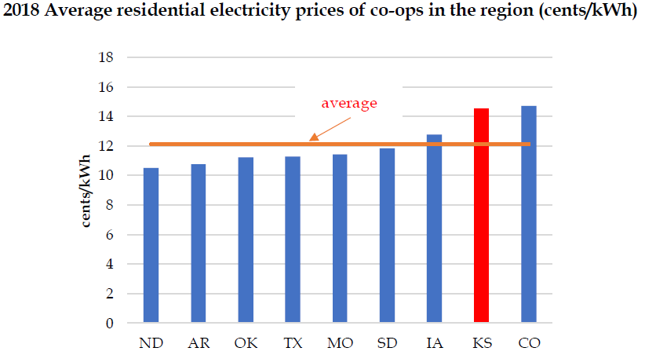
Kansas has 2nd-highest residental co-op rates

Slide 10
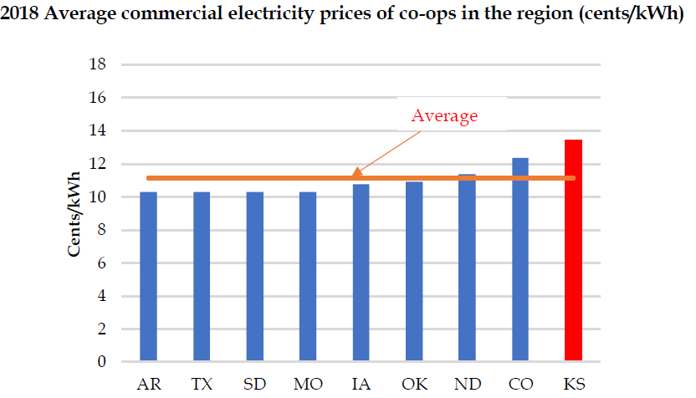
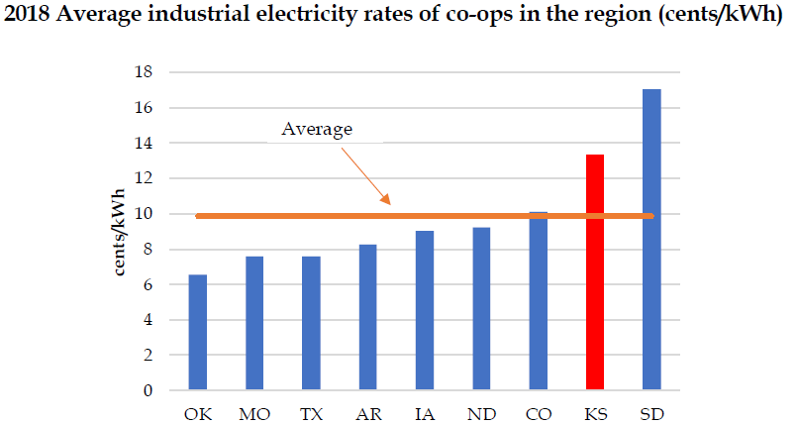
Kansas has worst commercial rates and 2nd-highest industrial co-op rates

Slide 11
High rates allow co-ops to pay high wages

Slide 12
Lyon County adopted bad zoning laws
County can dictate fence materials.
Tests to prove land is used for agricultural purposes if less than 40 acres.
Go through permit process to build outbuildings (scaled drawings, photos, property comparisons, etc.).
Judge can grant warrants to inspect homes for zoning violations.

Slide 13
Running for office is just one way to get involved
Precinct chairs.
Volunteer to help with campaigns.
Encourage civic and business groups to get presentations on major issues.
Share information on social media.

Slide 14
Contact Info
BeeHonestKansas.com
KansasPolicy.org SentinelKS.org
KansasOpenGov.org KansasJustice.org
Dave.Trabert@KansasPolicy.org
W (913) 213-5038
M (316) 993-4667

